Slide 1
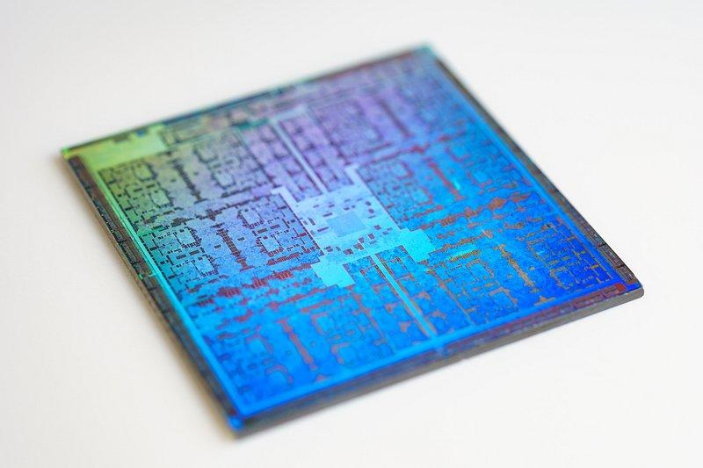
The case for fine-grain monitoring of AI compute
Dr Farhan Shafiq,
Katherine Biewer

Slide 2
Current approaches to tracking AI compute primarily rely on a handful of hardware proxies (like FLOP/s and bandwidth) that primarily track GPU/TPU progress. These metrics are becoming less useful for accurately tracking compute for AI

Slide 3
Key concepts
Compute
GPU
TPU
FLOPs
Bandwidth
Scaling

Slide 4

FLOP or FLOPS or FLOP/s???
flap?

Slide 5
FLOP
Floating Point OPeration
FLOPS, FLOP/s
Floating Point Operations Per Second)

Slide 6
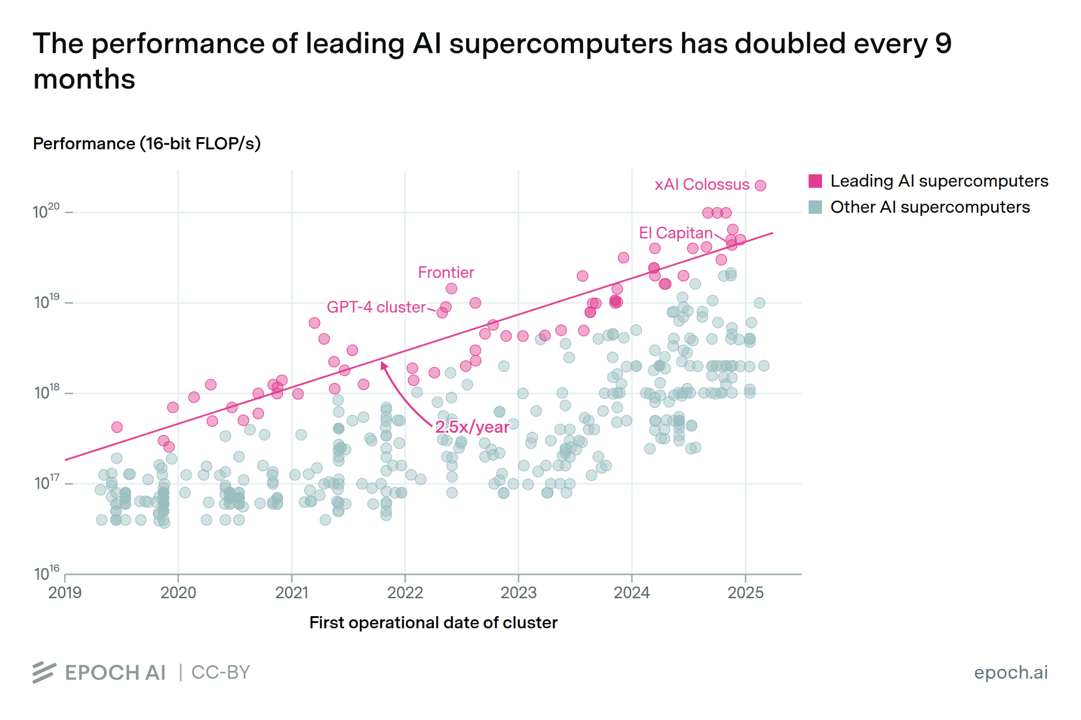
What are current approaches to tracking compute?

Slide 7
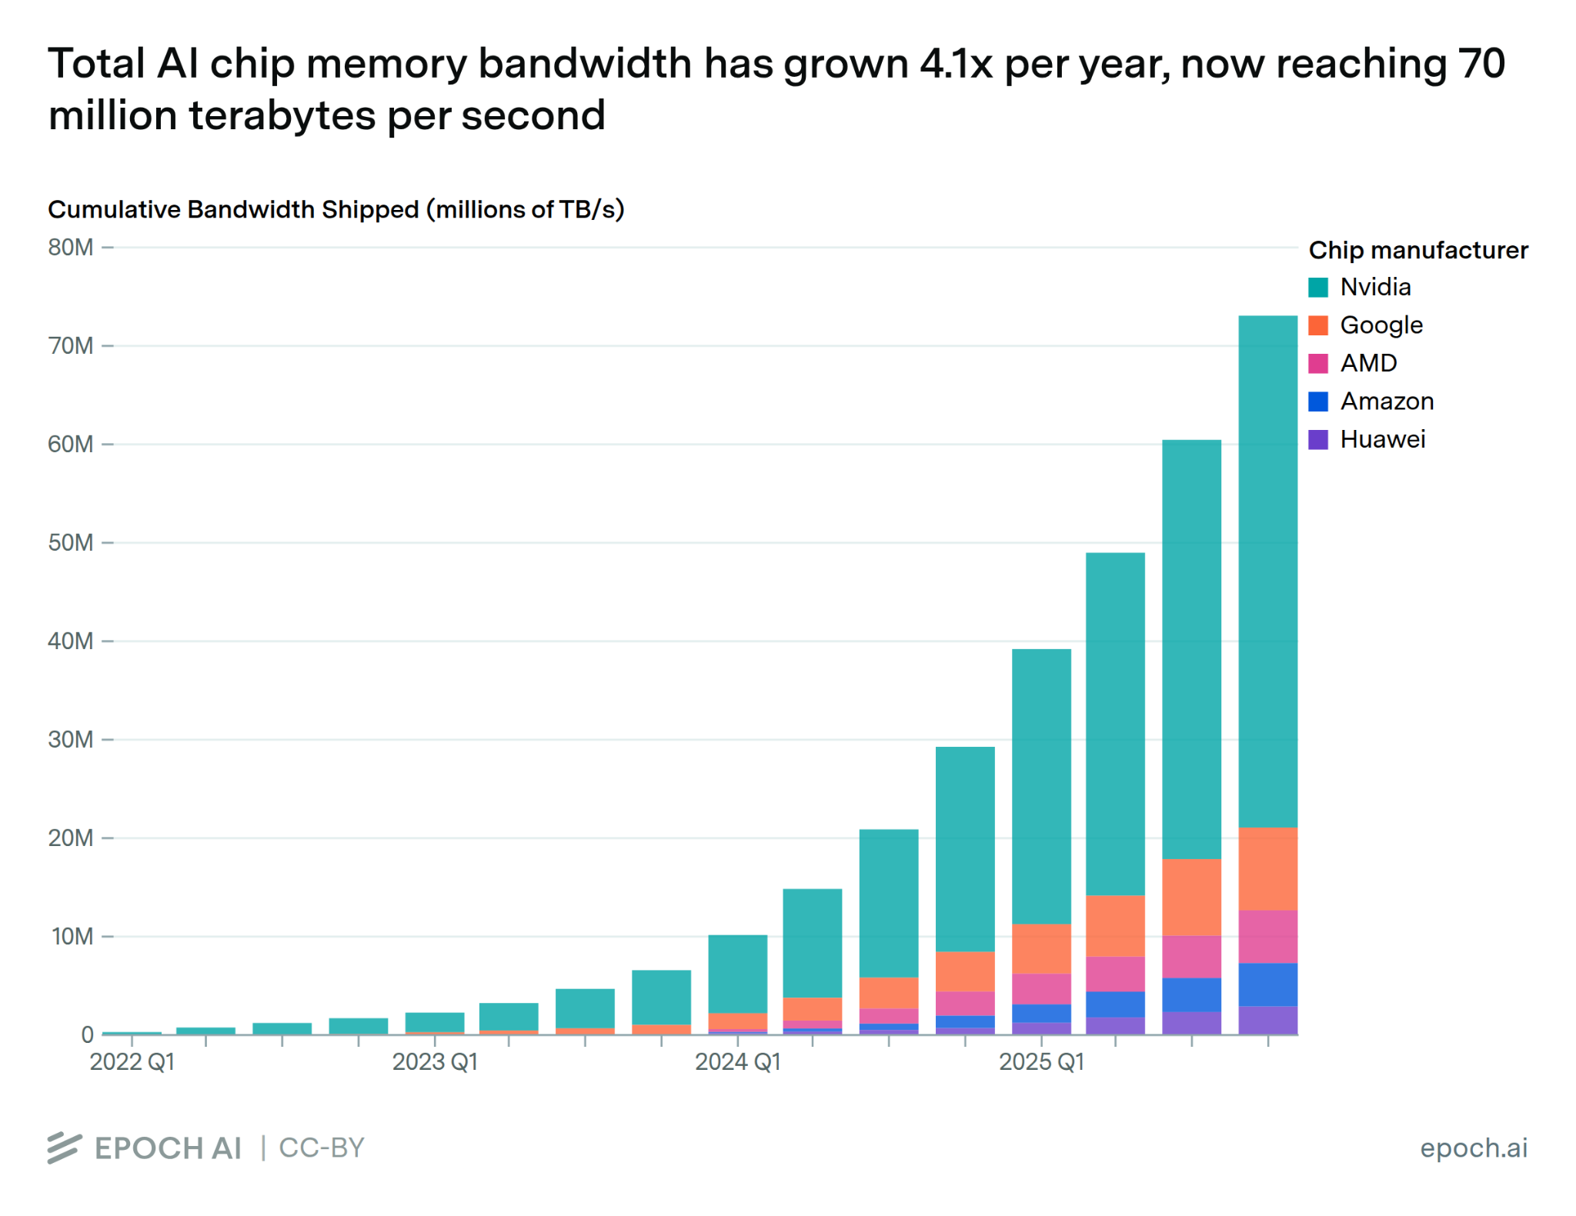
What are current approaches to tracking compute?

Slide 8
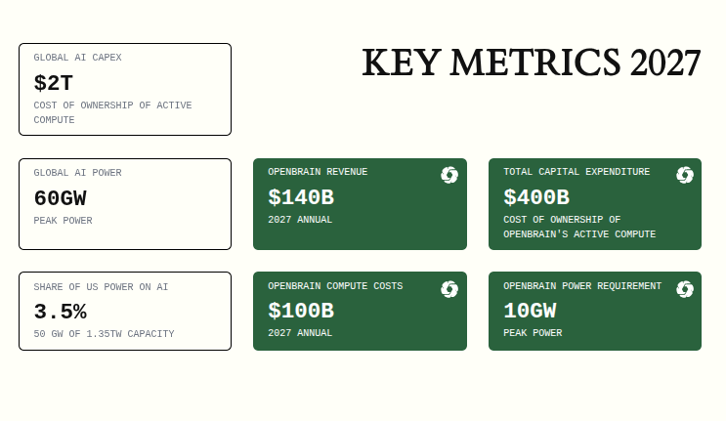
Power?
What are current approaches to tracking compute?
OpEx

Slide 9


Let’s try an analogy
What metrics do we use to measure car performance;
Top speed
Acceleration
Horsepower
CC
Cylinders

Slide 10

Top speed?
At 6PM on a weekday, the achieved speed depends on which road a car is “deployed” on.

Slide 11


CC?
When architectures change, metrics break.
CC
50
0

Slide 12

Paradigm shifts can go unnoticed under abstracted, uni-dimensional metrics

Slide 13
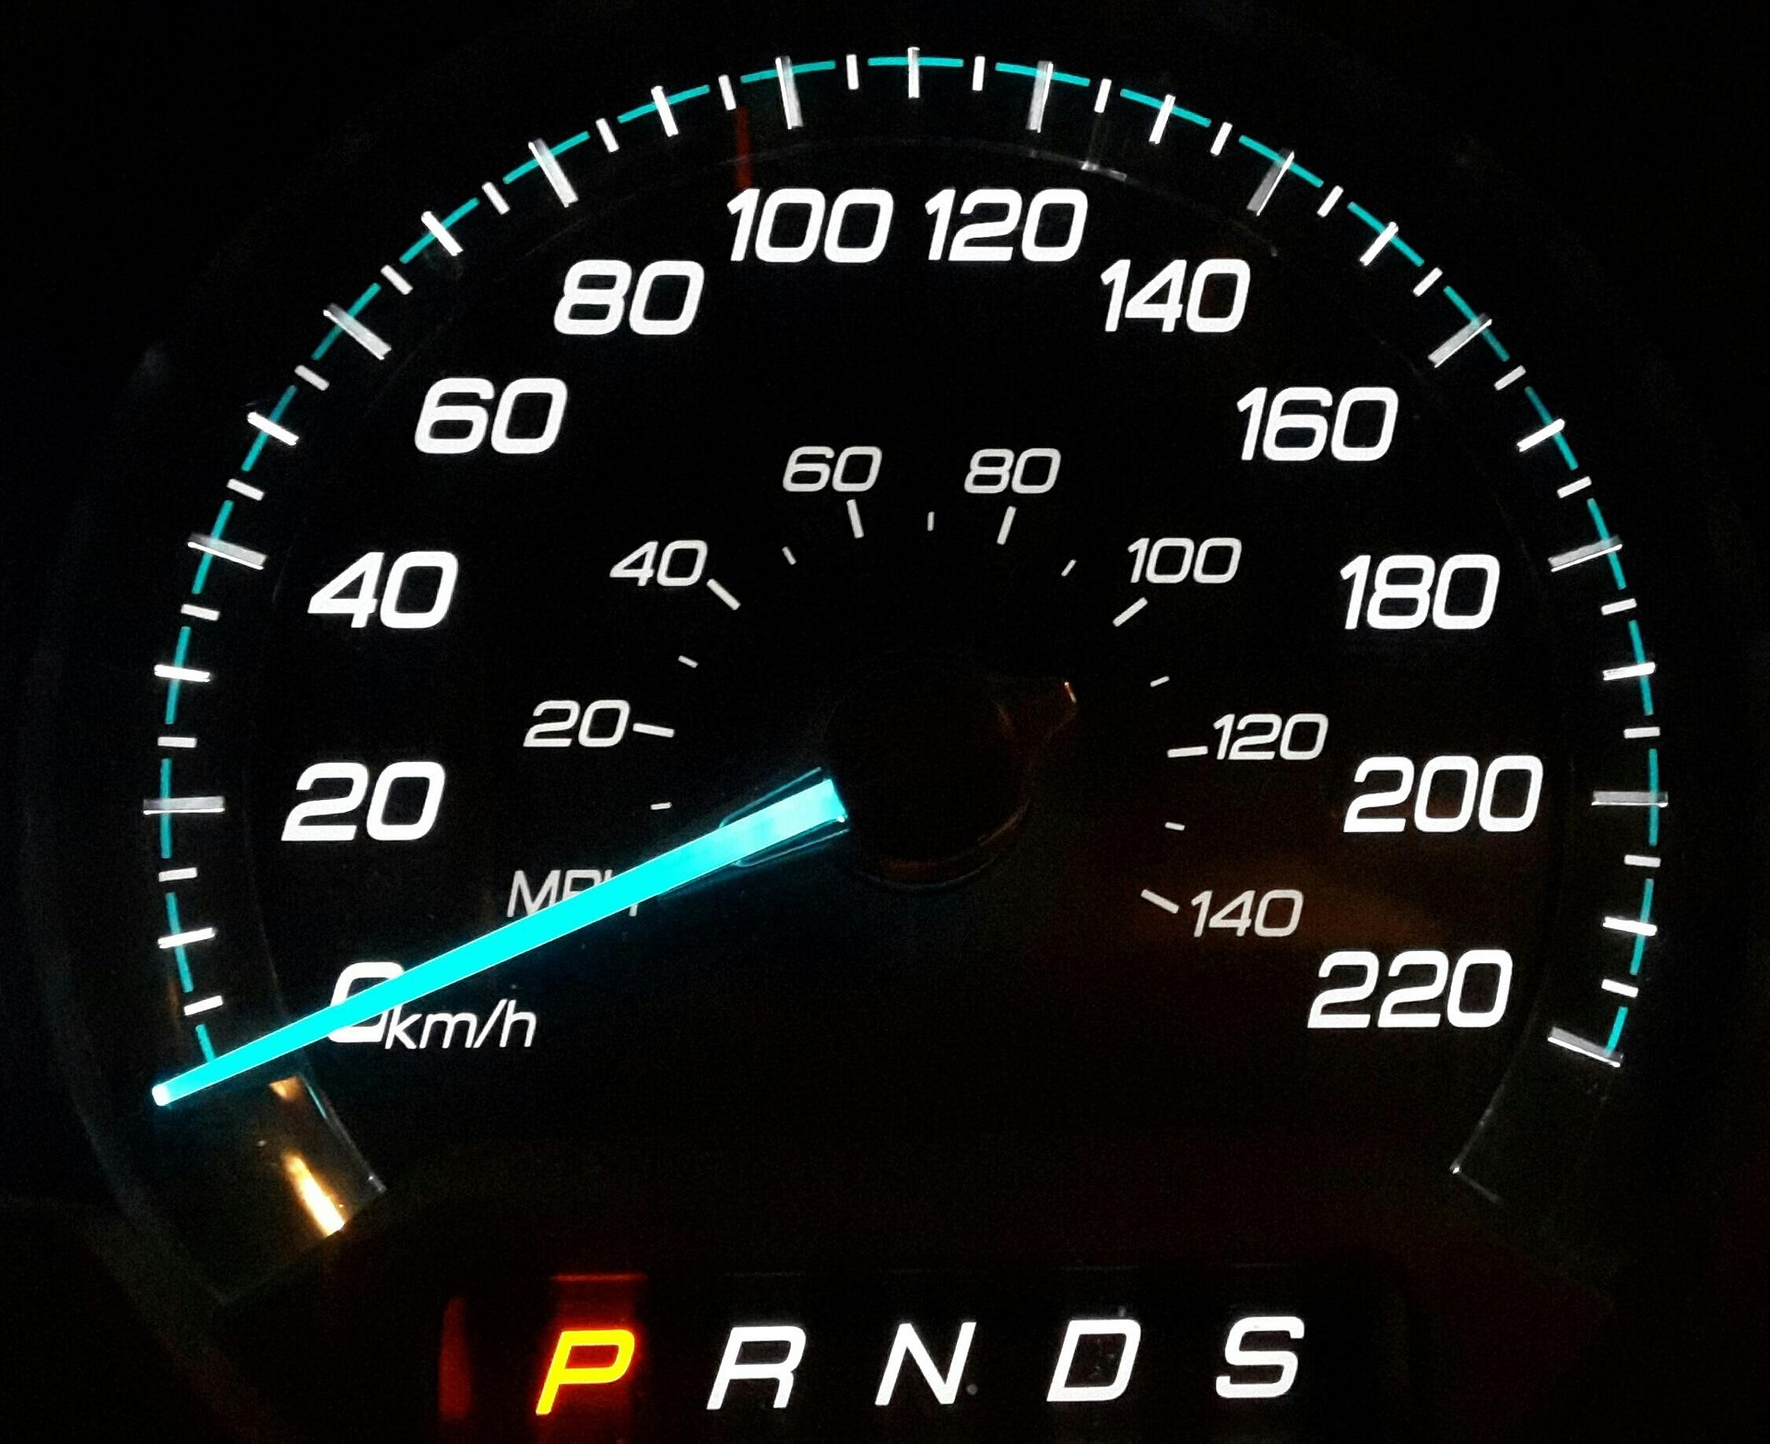
100 = 62.137…
When primitives or bit widths differ across architectures, we are comparing apples to oranges

Slide 14
After that over the top analogy,
let's get to actual compute

Slide 15
Current modeling gives an incomplete and inaccurate picture of compute capability because;
Tracking peak metrics (like peak FLOP/s, maximum bandwidth) only tells us about a chip’s theoretical performance ceiling, not the deployed capability.
As hardware architectures diversify and diverge from the GPU paradigm, the metrics we track are becoming inconsistent units of comparison across accelerators
We are missing second-order effects from improvements in design and manufacturing processes

Slide 16
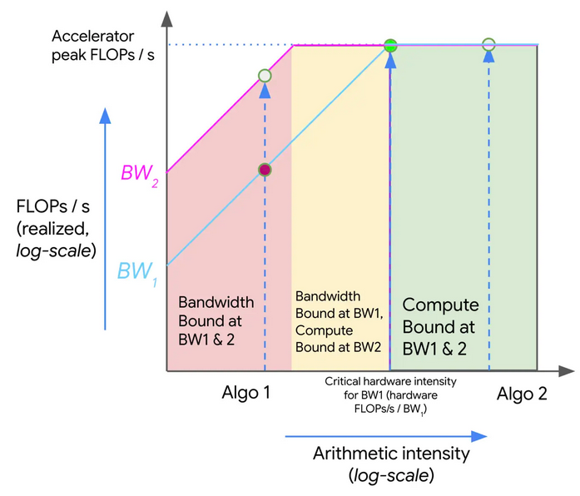
Peak Metrics and Theoretical rooflines
Rooflines are used to find the suitable hardware spec when architecting a hardware
Operational Intensity = Data Moved (bytes) / FLOPs.
OI is defined separately for an algorithm and every accelerator

Slide 17
Large gap between theoretical and achieved performance
Model FLOP Utilization (MFU), which measures the fraction of a chip's peak FLOP/s that is actually used, typically ranges from 35–50% for well-optimized workloads, and can be as low as 10–20% for less-optimized workloads. Utilization can vary based on deployment setup like batching, parallelism, scale-out infrastructure etc.

Slide 18
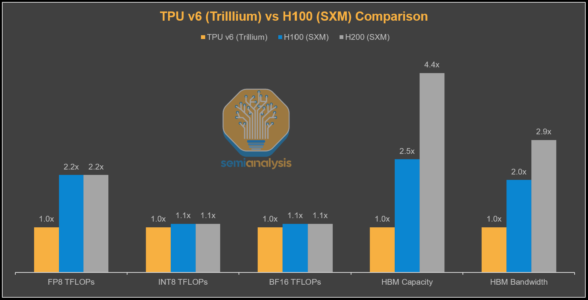
Architecture changes significance of metrics
HBM bandwidth is a defining feature of AI accelerators

Slide 19
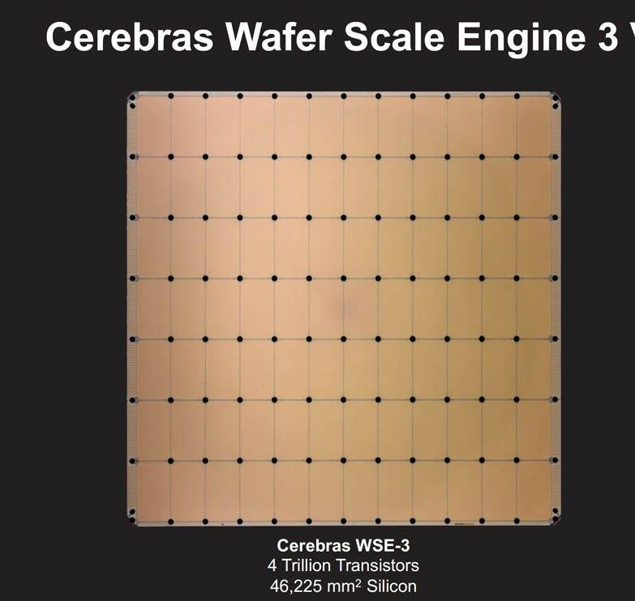
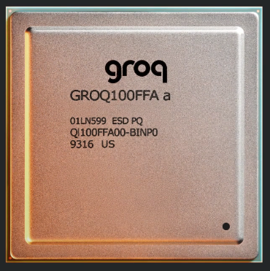
Not just HBM
GROQ LPU
HBM bandwidth = 0
SRAM bandwidth = 150 TBs/s
Cerebras WSE
HBM bandwidth = 0
SRAM bandwidth = 21 PB/s

Slide 20
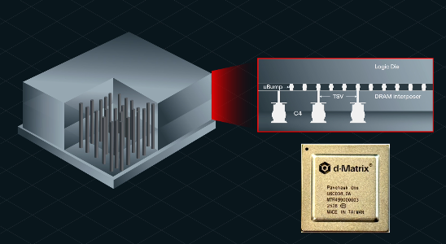
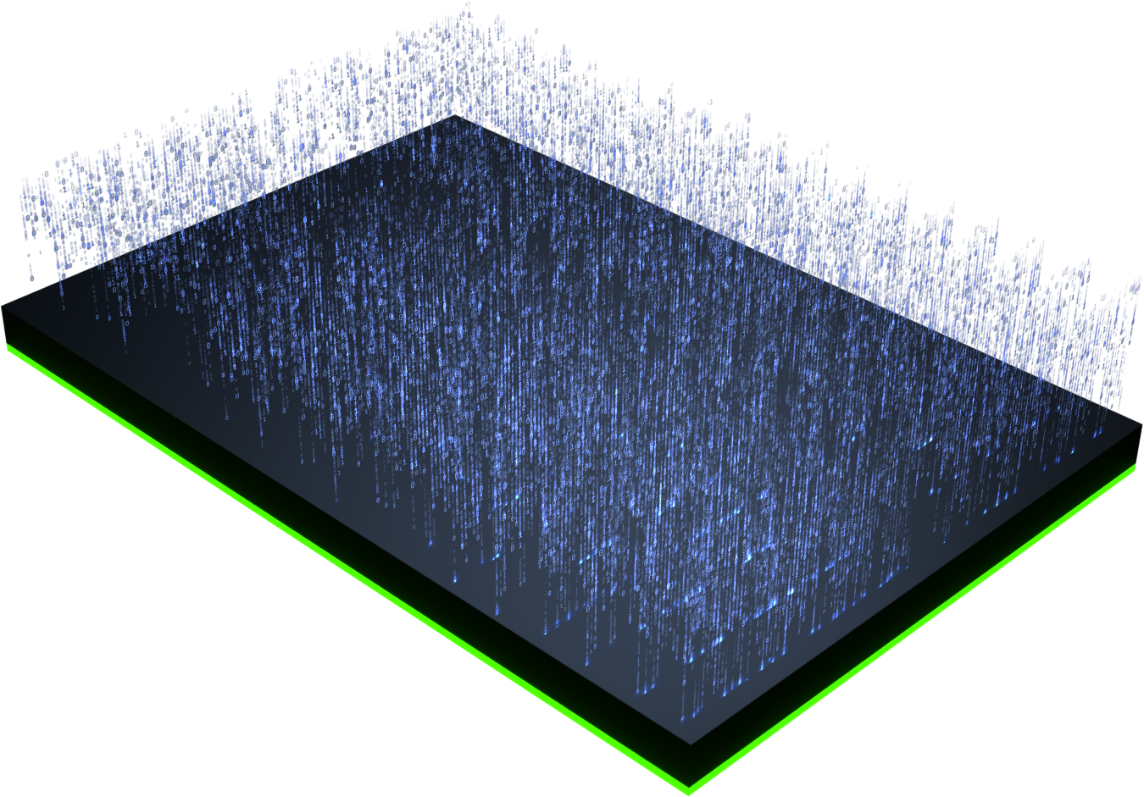
Power efficiency prediction models may break
Current models assume 25% power efficiency gain by 2027, however, future power requirements could be offset dramatically by factors like Memory centric compute, 3D stacking, Low bit-width models, space deployed data centres.
d-matrix
Vertical compute

Slide 21
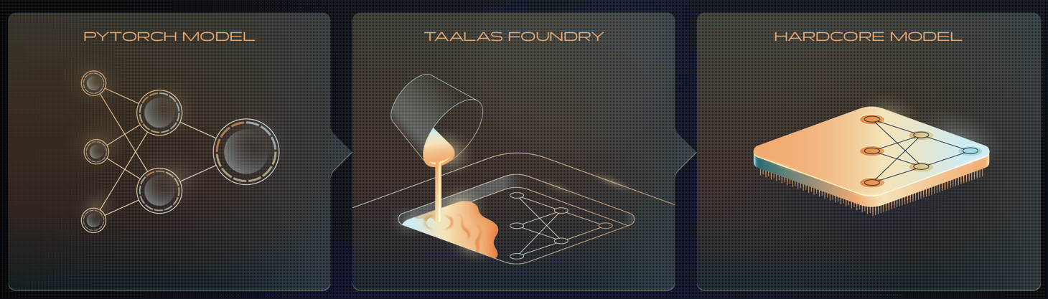
Meaning of a FLOP can change
input
input
output
output
weight
weight
Taalas

Slide 22
How can we bridge these gaps?

Slide 23
A more accurate way to think about hardware advancement
The chip architecture design (computing paradigm, memory architecture, numerical format, compute primitives).
The design and manufacturing processes (integration of AI into hardware design flows, HW/SW co-design, manufacturing advancements).
The deployment of the chip (inference stack, kernels, scale-out infrastructure, utilization, tokenomics, etc).

Slide 24
Questions, Comments,
Suggestions, Discussions

